Slide 1
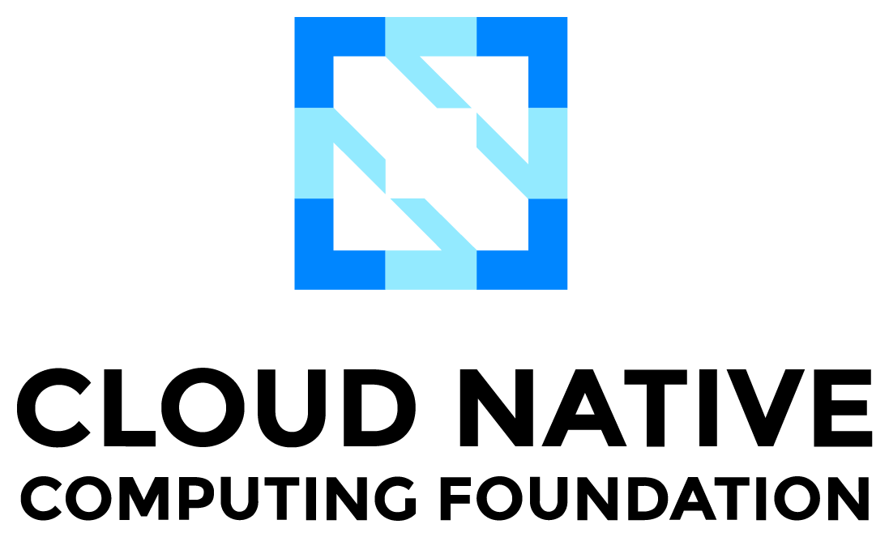


All Hands ARGO

Slide 2

Utkarsh Mishra Sr. Site Reliability Engineer @ Mitra AI, Ex-Tata Elxsi Open-Source Contributor to OSM by ETSI
LinkedIn@utkarsh-mishra-um10
Github@Sir-gits-a-lot
#TEAMCLOUDNATIVE #CloudNativePune
#CNCGPUNE
#CLOUDNATIVEBHARAT

Slide 3

01
Problem Statement
AGENDA
02
The Infrastructure as Data Movement
03
Crossplane Intro
04
Use Cases

Slide 4












THE Problem Statement
Prod is down!!!
Biz Team
Dev Team
Ops Team
Wall of Confusion
“Works on my local”
Working till late to resolve the issue.
RCA: Somebody used kubectl or AWS Management Console.

Slide 5


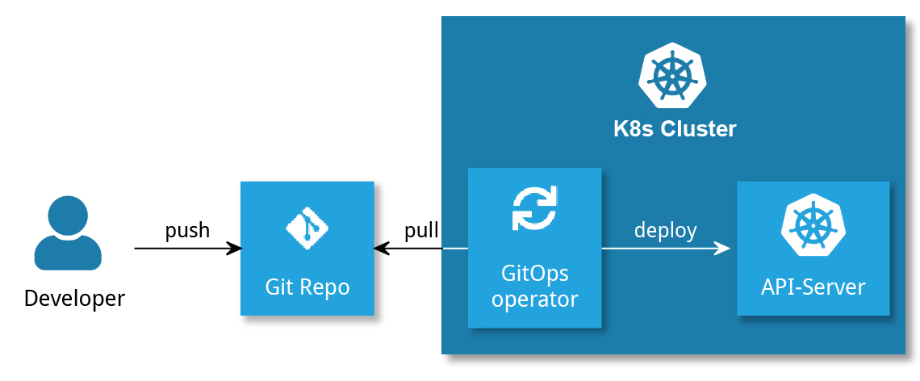

GitOps In a Nutshell
GitOps is a way to implement WYSIWYG
WYSIWYG – What You See Is What You Get

Slide 6
Argo CD is one of the stack of tools built under the Argo Project aimed at simplifying continuous delivery of application to K8s in GitOps way.
Open source: Argo was accepted to CNCF on March 26, 2020, at the Incubating maturity level and then moved to the Graduated maturity level on December 6, 2022.
Declarative: Based on the principles of GitOps, Argo CD is a completely declarative tool which means all the configuration of Argo CD can be done using simple declarative manifest files.
Integration with K8s Ecosystem: Since Argo CD leverages CRDs and controllers, it integrates with K8s ecosystem easily.
Ease of Management: UI based view to managed Workload + Infra from a single point.
Working: Argo CD follows the GitOps pattern of using Git repositories as the source of truth for defining the desired application state.
Argo CD Interaction Model: Web UI which provides real-time view of application activity. CLI for automation and CI integration. The other way is to use GRPC/REST to send requests to Argo CD’s API.
Multi-Cluster Management: Ability to manage and deploy to multiple clusters and monitor multiple git repositories so that Argo CD doesn’t become a dependency for each cluster that we create. One instance of Argo CD can manage deployment to multiple K8s cluster using 1 or more Git repositories as the source of truth.
Notifications: Automated configuration drift detection and visualization and notifications to slack, teams, etc.
Disaster Recovery: Use argocd admin command to import/export all argocd data for migration or as a preventive mechanism.

Slide 7
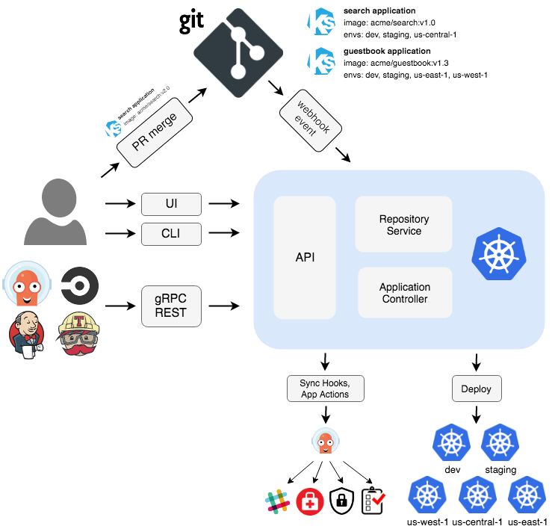
Argo CD Zoomed

Slide 8
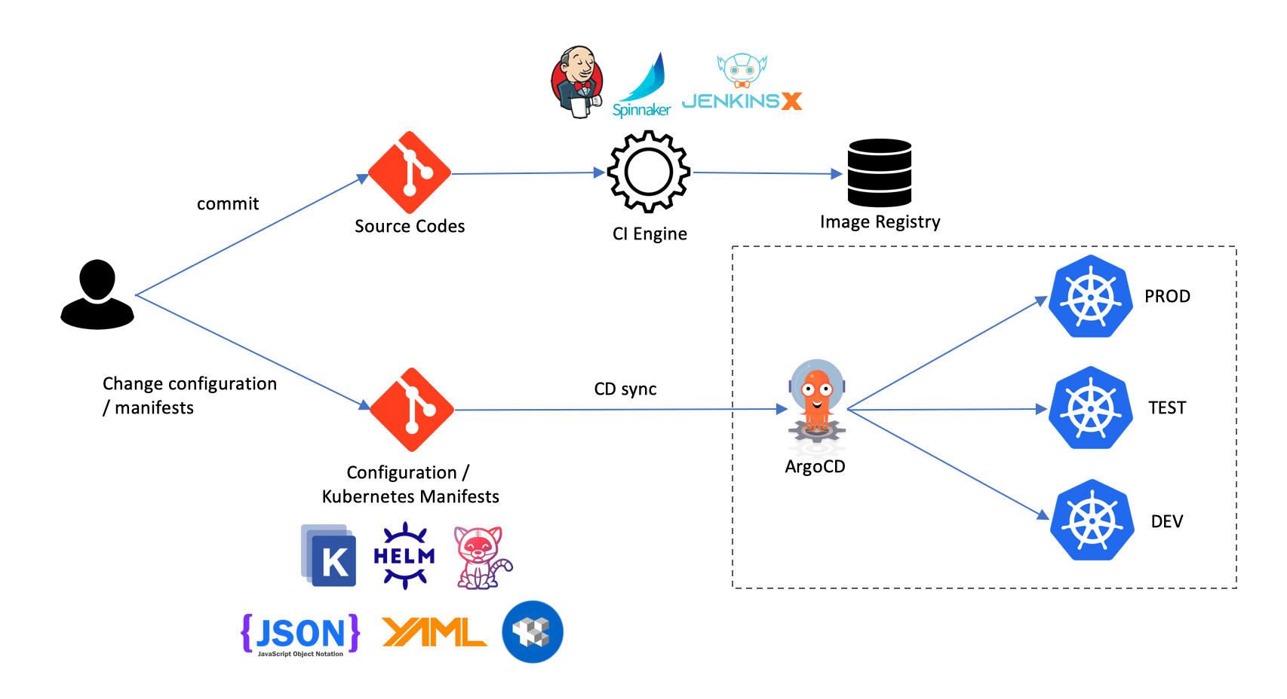
Argo CD’s Implementation of GitOps

Slide 9
Long Live Cloud native!

Slide 10
Thanks, CNCF Pune
Open for Q&A…

